Slide 1

A Novel Image Segmentation Technique for Improving Plant Disease Classification with Deep Learning Models
by
Basava Ramya
Roll No. 224G1A0581
P. Ayesha
Roll No. 224G1A0508
R. Sai Sowmya Sree
Roll No. 224G1A0592
Under the guidance of
Dr. M. Ranjith Reddy ,qualification
Designation
Department of Computer Science and Engineering
Srinivasa Ramanujan Institute of Technology
Autonomous
Rotarypuram Village, B K Samudram Mandal, Ananthapuramu – 515701.
2025-2026

Slide 2

Contents
Title Justification
Abstract
Problem statement
Objectives of Project
Literature survey for objectives
Proposed Work -(Methods to be followed for proposed system)
References
GitHub Link
Queries

Slide 3
Title Justification
The title “A Novel Image Segmentation Technique for Improving Plant Disease Classification with Deep Learning Models” is justified because the project focuses on:
Developing advanced segmentation methods to isolate diseased leaf regions.
Improving accuracy of plant disease detection by preprocessing images through segmentation.
Using deep learning architectures (UNet++, DeepLabV3, Swin Transformer) that introduce novelty in technique and comparative evaluation.
Providing a deployable Flask web application, making the system practically useful.
This aligns with the research goal of enhancing agricultural disease diagnostics through modern AI techniques.

Slide 4
Abstract
This project develops a deep learning–based solution for automated segmentation of leaf regions to support plant disease identification. Using the Leaf Disease Segmentation Dataset from Kaggle, three models UNet++, DeepLabV3 (both using ResNet34 encoders), and a custom Swin Transformer model are implemented to generate binary masks that isolate infected leaf areas. The dataset undergoes preprocessing using Albumentations, including resizing, augmentation, and normalization.
The models are trained for 10 epochs using Adam optimizer, with Dice Loss and BCE With LogitsLoss as appropriate. Performance is evaluated using Dice Score and IoU, where UNet++ achieves the highest accuracy (Dice: 0.8401, IoU: 0.7423). The best-performing model is deployed in a Flask web application with user authentication and image upload features, supported by a MySQL database. The project demonstrates the effectiveness of deep learning for precise plant disease segmentation and real-world usability through deployment.

Slide 5
Problem Statement
Identifying diseased leaf regions manually is time-consuming, error-prone, and subjective.
Variations in lighting, leaf shapes, and disease patterns make traditional image processing methods ineffective.
Accurate segmentation is required to improve disease classification performance.
There is a need for an automated, reliable, scalable solution that can precisely isolate leaf regions for further diagnosis.

Slide 6
Objectives of Project
Research Objective :
To analyze the effectiveness of deep learning–based image segmentation techniques in improving plant disease classification accuracy for agricultural applications.
Technical Objective
To develop and compare three segmentation models (UNet++, DeepLabV3, and Swin Transformer) and deploy the best-performing model in a Flask web application for real-time leaf disease segmentation.

Slide 7
Literature survey for objectives
Recent studies highlight the importance of image segmentation to enhance plant disease detection accuracy.
UNet-based models are widely used due to their skip connections and strong feature extraction capabilities.
Transformer models, such as Swin Transformer, offer global attention mechanisms but require optimization for segmentation tasks.
Previous works lack comparative evaluation across multiple architectures, which this project provides.
Existing literature supports deep learning adoption in agriculture, but deployment-focused research remains limited.

Slide 8
Proposed System
The proposed system automates leaf disease segmentation using deep learning models. It consists of:
Dataset Preprocessing:
Resize images, normalize, convert masks to binary, and apply light augmentation.
Model Development:
Implement three models — UNet++, DeepLabV3, and Swin Transformer to segment leaf regions.
Training & Evaluation:
Train models using Adam optimizer and Dice/BCE loss; evaluate using Dice Score and IoU metrics to identify the most accurate model.
Deployment:
Integrate the best model (UNet++) into a Flask web application with user login, image upload, and real-time segmentation output.

Slide 9
References
[1]. F. Alam, “Leaf Disease Segmentation Dataset,” Kaggle Repository, 2021.
[2]. Olaf Ronneberger et al., “U-Net: Convolutional Networks for Biomedical Image Segmentation,” MICCAI, 2015.
[3]. Liang-Chieh Chen et al., “DeepLab: Semantic Image Segmentation with Deep Convolutional Nets,” TPAMI, 2018.
[4]. Liu et al., “Swin Transformer: Hierarchical Vision Transformer Using Shifted Windows,” ICCV 2021.

Slide 10
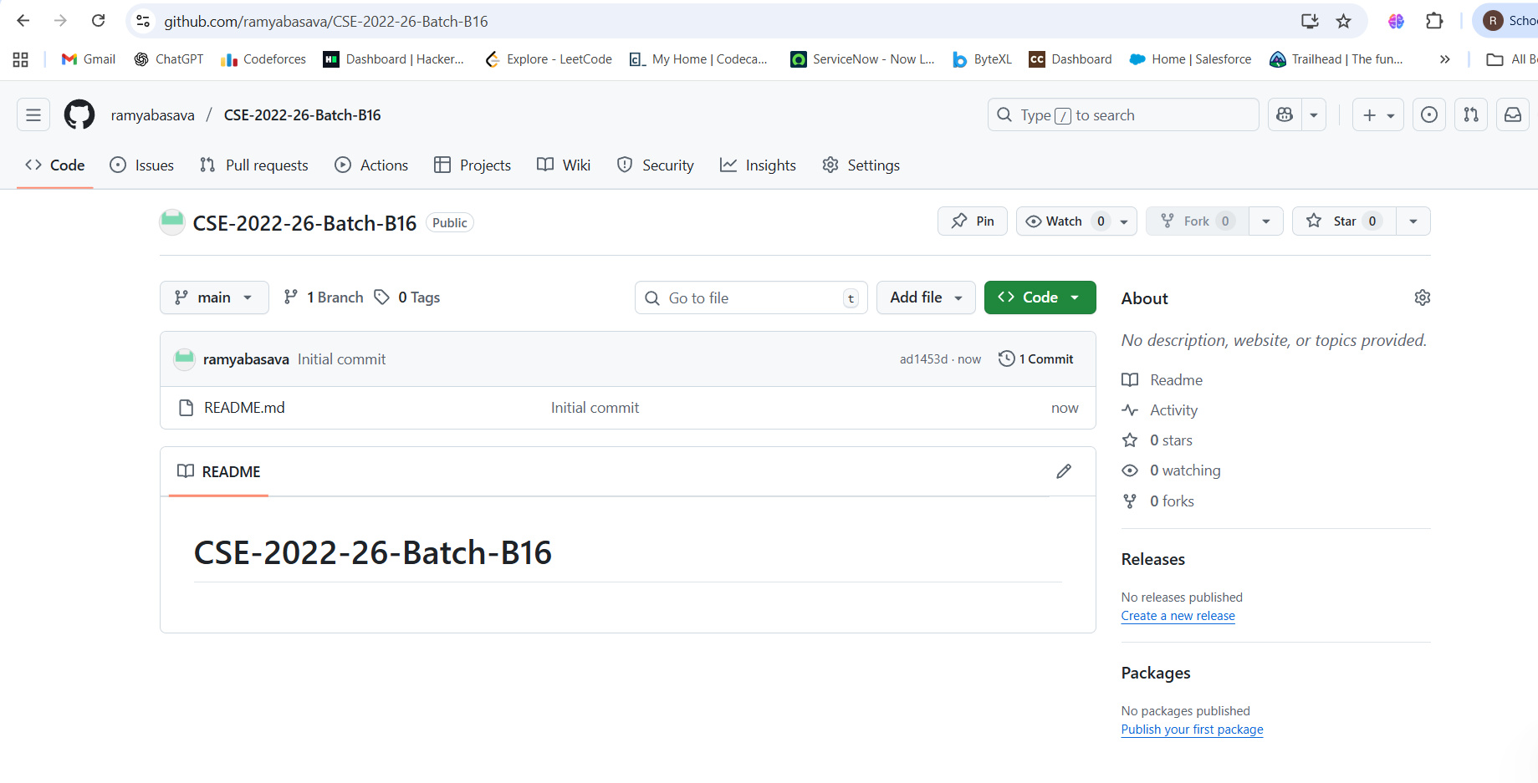
Git Hub Dashboards of each student
link of the Github: https://github.com/ramyabasava/CSE-2022-26-Batch-B16.git

Slide 11
Any Queries?

